Slide 1




Bringing Power BI into the Dataverse through the Magic of Synapse
Scott Sewell
Principal Program Manager
Power BI Customer Advisory Team (PBICAT)

Slide 2
Bringing Power BI into the Dataverse through the Magic of Synapse
Scott Sewell
Principal Program Manager
Power BI Customer Advisory Team (PBICAT)

Slide 3

Reporting options on Dataverse data

Slide 4

Basic Dataverse to Power BI Choices
1) Direct Query using Dataverse Connector
Report Design and Data Model

Slide 5
Basic Dataverse to Power BI Choices
Report Design and Data Model
2) Import mode using Dataverse Connector
Vertipaq

Slide 6
Basic Dataverse to Power BI Choices
Report Design and Data Model
Vertipaq
3) Import from Synapse Analytics SQL

Slide 7
Basic Dataverse to Power BI Choices
1) Direct Query using Dataverse Connector
Report Design and Data Model
2) Import mode using Dataverse Connector
Vertipaq
3) Import from Synapse Analytics SQL

Slide 8
Basic Dataverse to Power BI Choices
Report Design and Data Model
Vertipaq
3) Import from Synapse Analytics SQL

Slide 9
What is Synapse Link for Dataverse?
Azure Synapse Analytics
Auto-Created Views
Azure Synapse Link for Dataverse
Power BI
Azure Data Lake Storage
https://docs.microsoft.com/en-us/powerapps/maker/data-platform/export-to-data-lake

Slide 10


What is Synapse Link for Dataverse?
Azure Synapse Analytics
Serverless SQL
Azure Synapse Link for Dataverse
Azure Data Lake Storage
https://docs.microsoft.com/en-us/powerapps/maker/data-platform/export-to-data-lake

Slide 11

Azure Synapse Link for Dataverse
Benefits:
Getting the Dataverse data to start flowing to the Azure Data Lake is a matter of clicks.
Considerations:
Azure Data Lake and Azure Synapse Analytics are billed on an Azure subscription.
Comes with a serverless SQL pool endpoint you can query with T-SQL.
Works as a data warehouse
Large volumes and complex query support in Synapse for additional data support and enrichment.
Once the data is out of Dataverse, the configured security model is lost (need to add Row Level Security).
If the customer hits Read/Write contention, there is a private preview for enabling an hourly snapshot for reading and other enhancements in the planning stage.
Date-Time is in UTC format

Slide 12
Setup of Azure Synapse Link

Slide 13
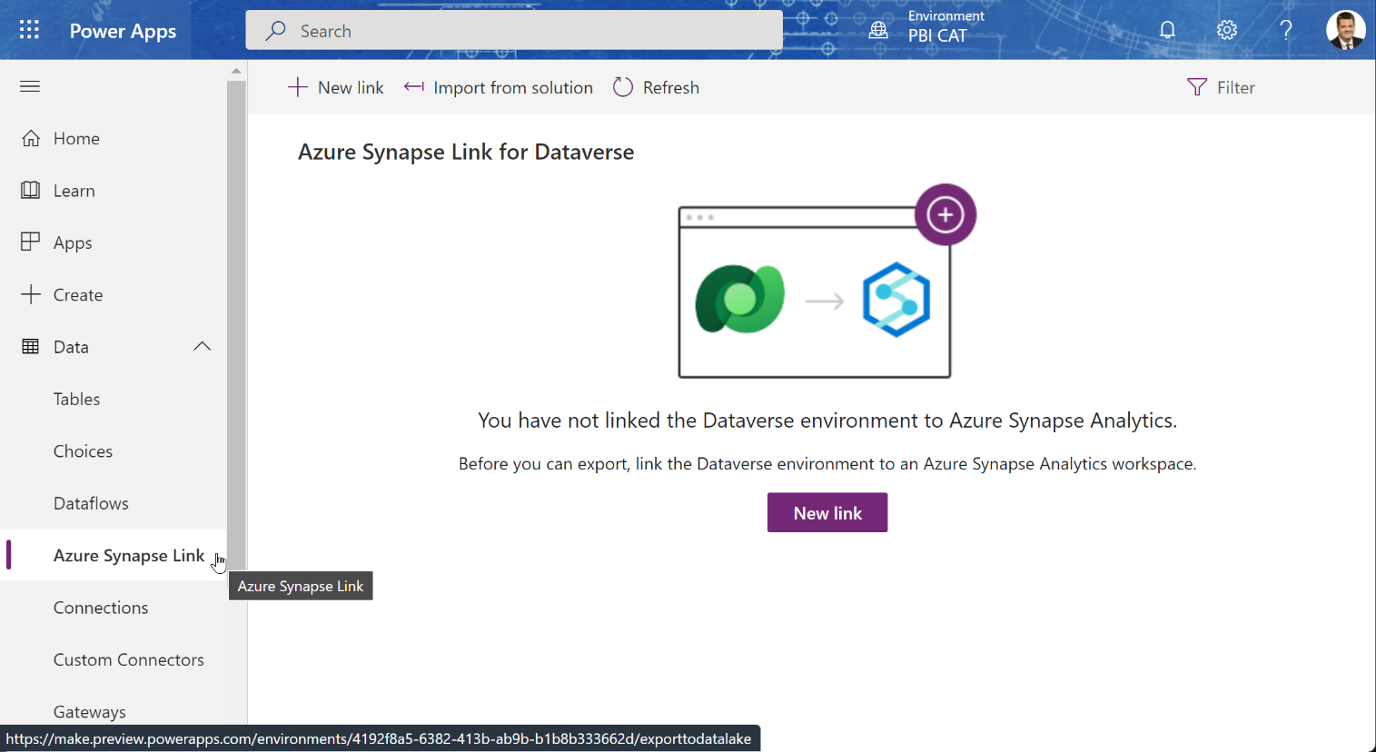
Setup of Synapse Link
Power Apps Administration Page
Https://make.PowerApps.Com

Slide 14
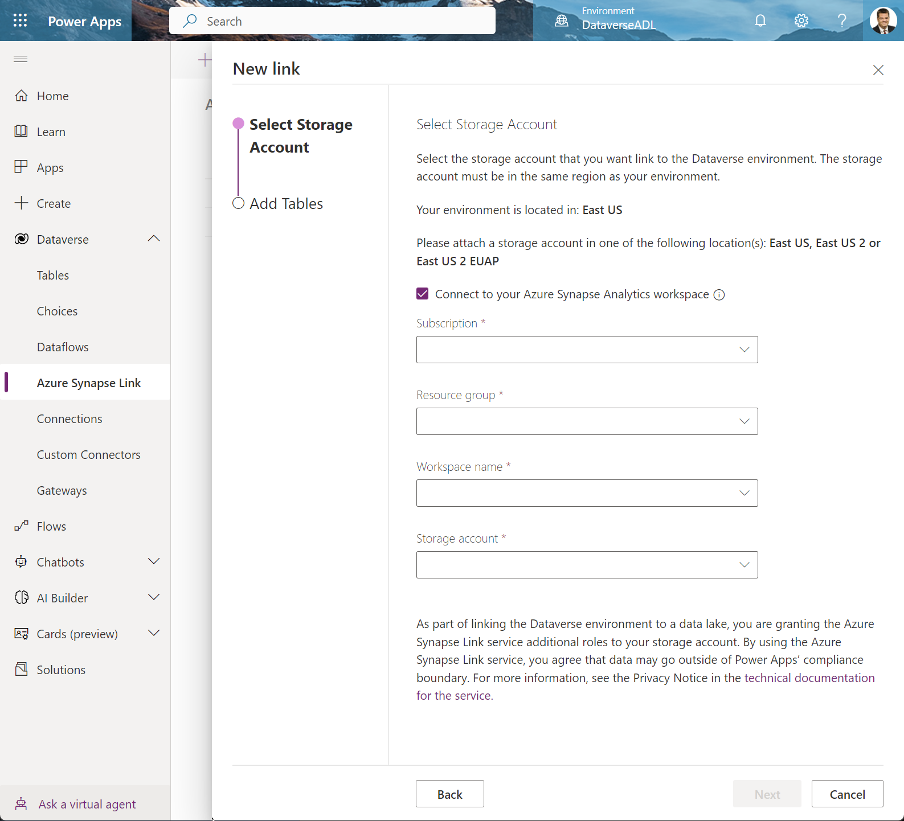
Create Synapse Link
Choose the Storage account and Synapse workspace:
If you already have a Synapse Workspace, click the checkbox to connect to the existing workspace.

Slide 15
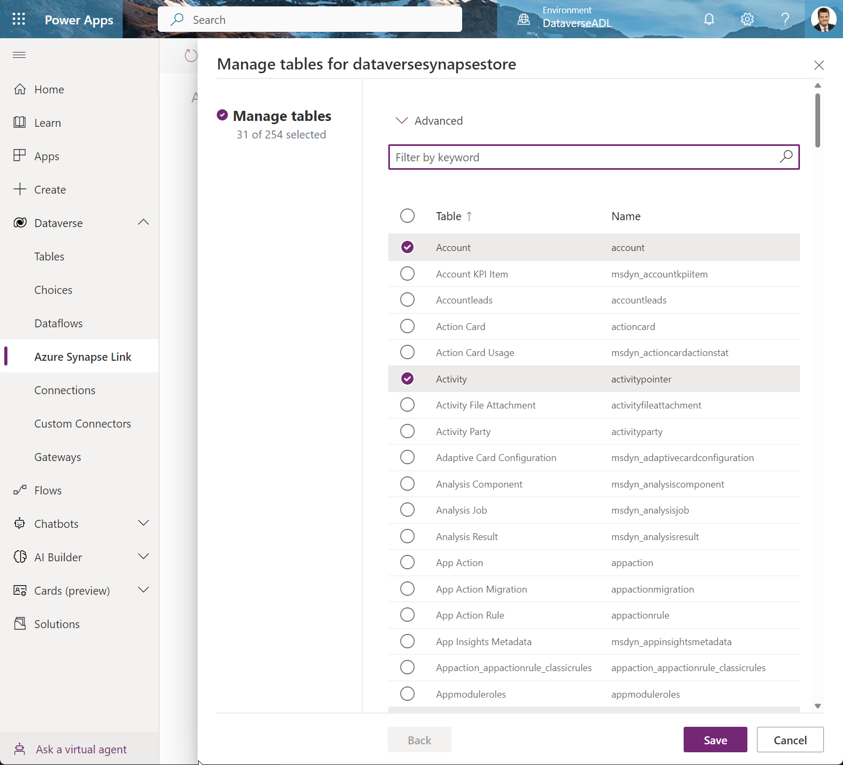
Choose Tables
Choose the tables you want to sync to the Azure data lake – (you can add more later.)

Slide 16
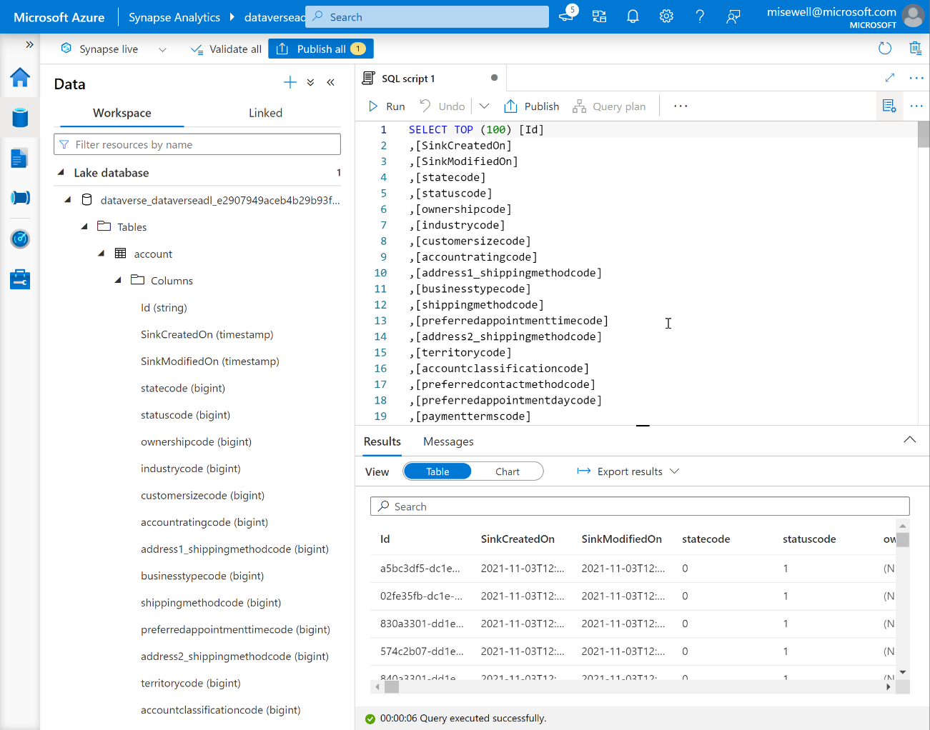
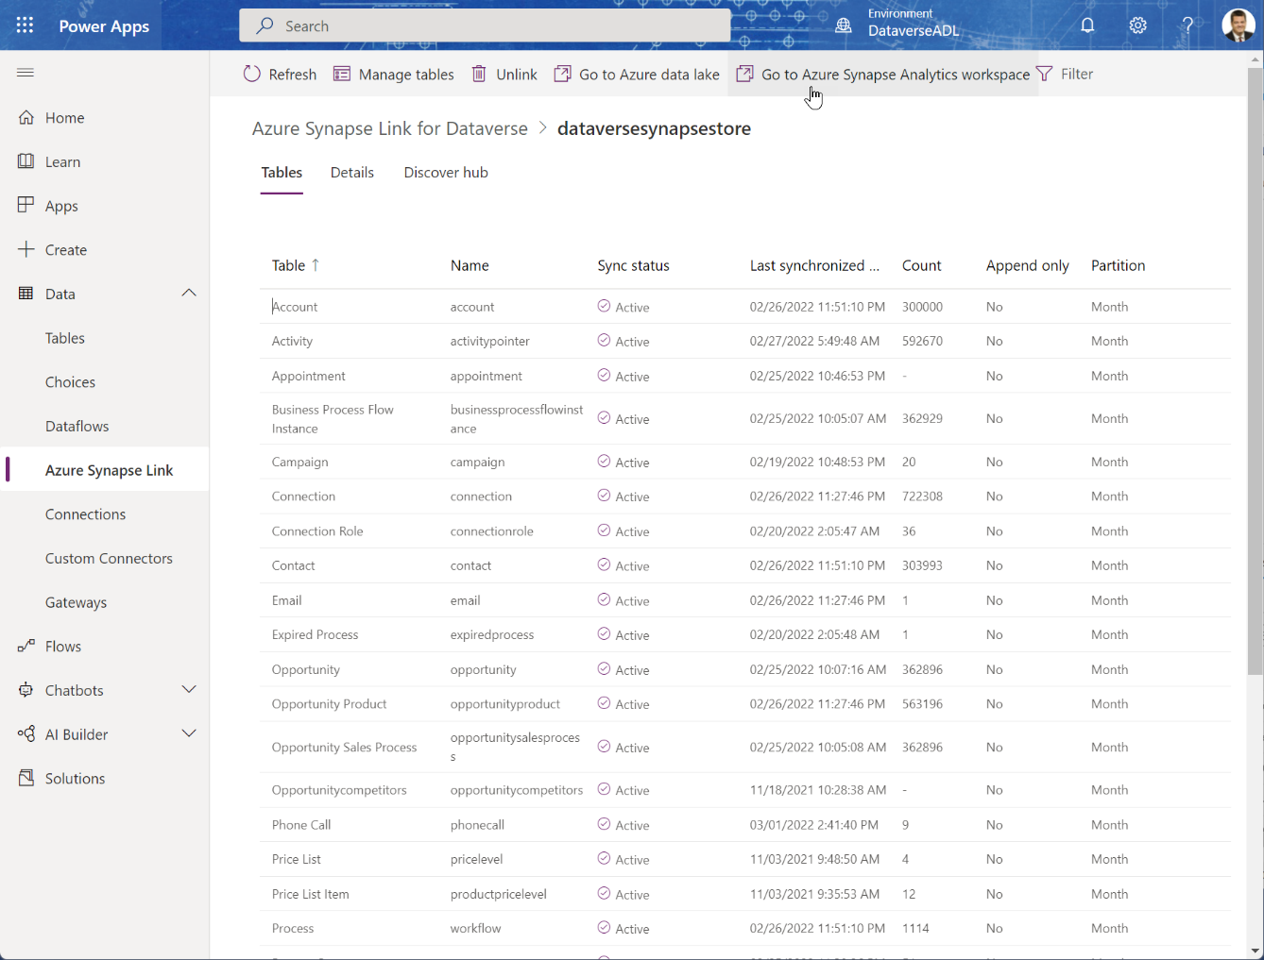
Open Synapse Workspace

Slide 17
Azure Synapse Link for Dataverse
Azure Synapse Analytics
Auto-Created Views
Azure Synapse Link for Dataverse
Power BI
Azure Data Lake Storage

Slide 18
Azure Synapse Link for Dataverse Suggestion for Report Creator’s Ease of Use
Azure Synapse Analytics
Auto-Created Views
Custom Report Views
Azure Synapse Link for Dataverse
Power BI
Azure Data Lake Storage

Slide 19
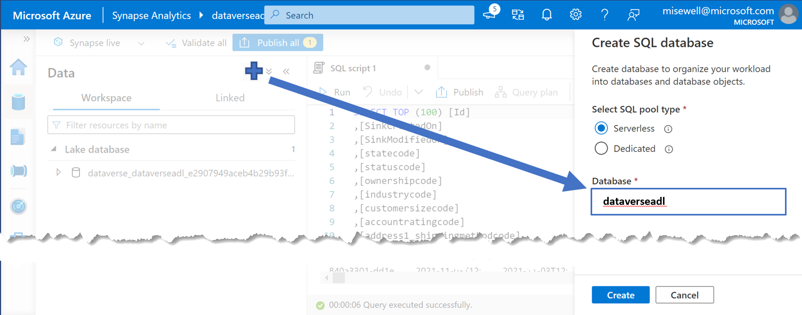
Create a companion Serverless SQL Database for Views
The Serverless SQL DB auto-created by the Synapse Link is read-only.
Although you could point Power BI directly to it, creating a 2nd Serverless SQL DB to hold your own configured views for reports give you flexibility to create a simpler and ‘cleaner’ data source.
Azure Synapse Analytics – ServerlessSQL
Azure Synapse Link for Dataverse
Azure Data Lake Storage
Custom Report Views
Auto-Created Views

Slide 20
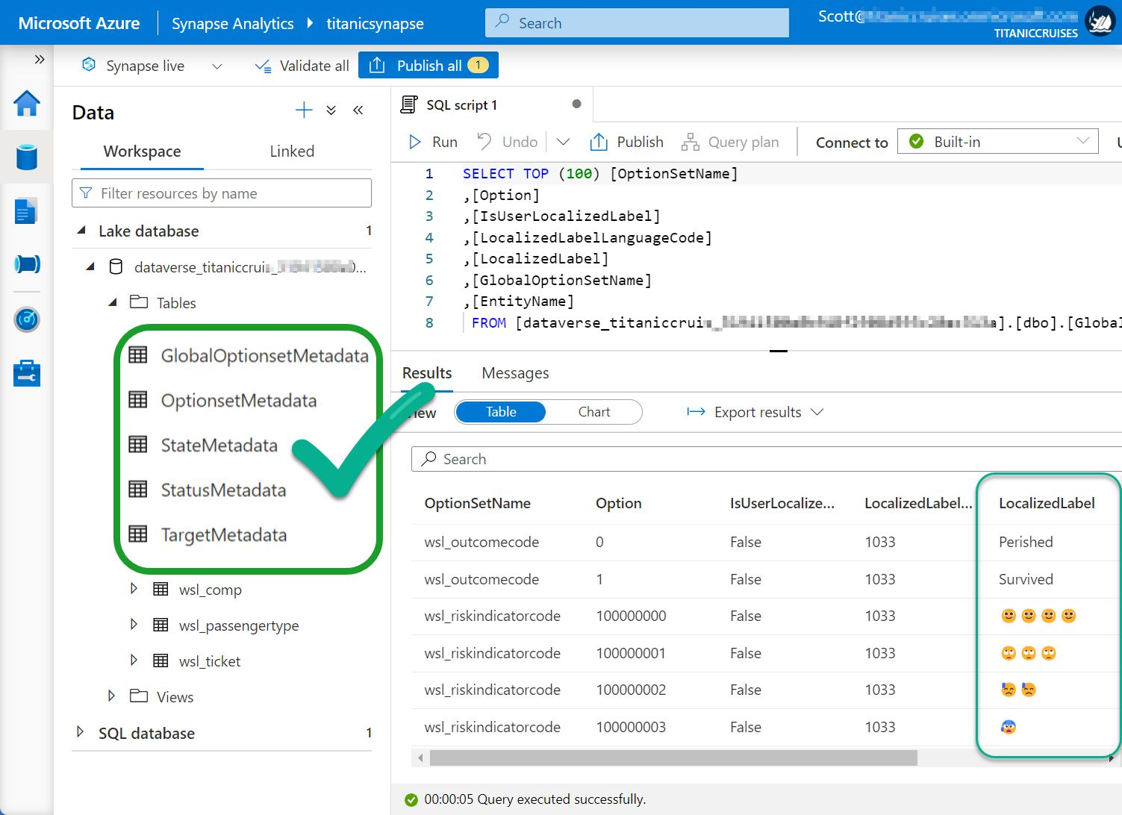
Use the metadata views to access the “Choice” Labels from Dataverse
The auto-created table views only return the numeric value associated with ‘Choice’ fields, State Code or Status Reason.
In a view, join the base table to the appropriate Metadata table to retrieve the needed label.
Documentation is here: Access Dataverse choice labels directly from Azure Synapse Link for Dataverse - Power Apps

Slide 21
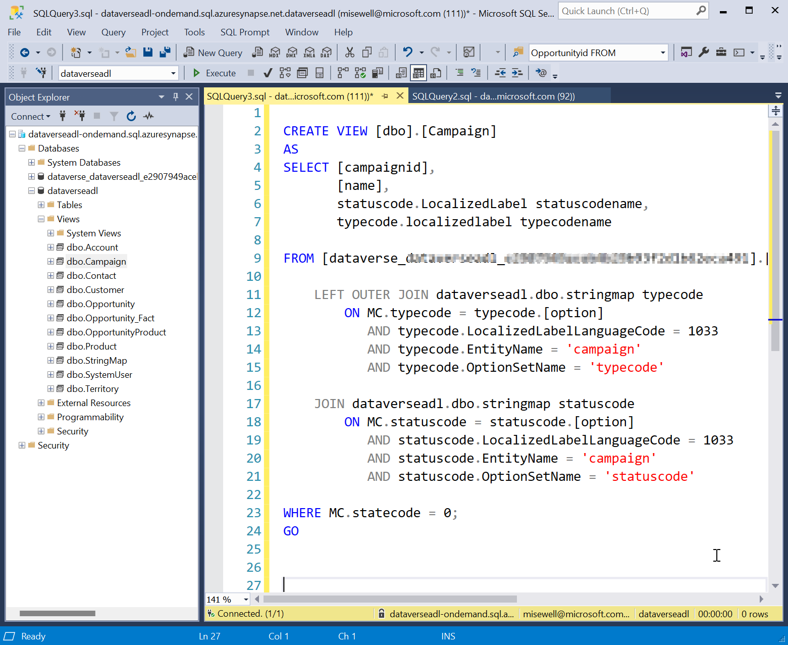
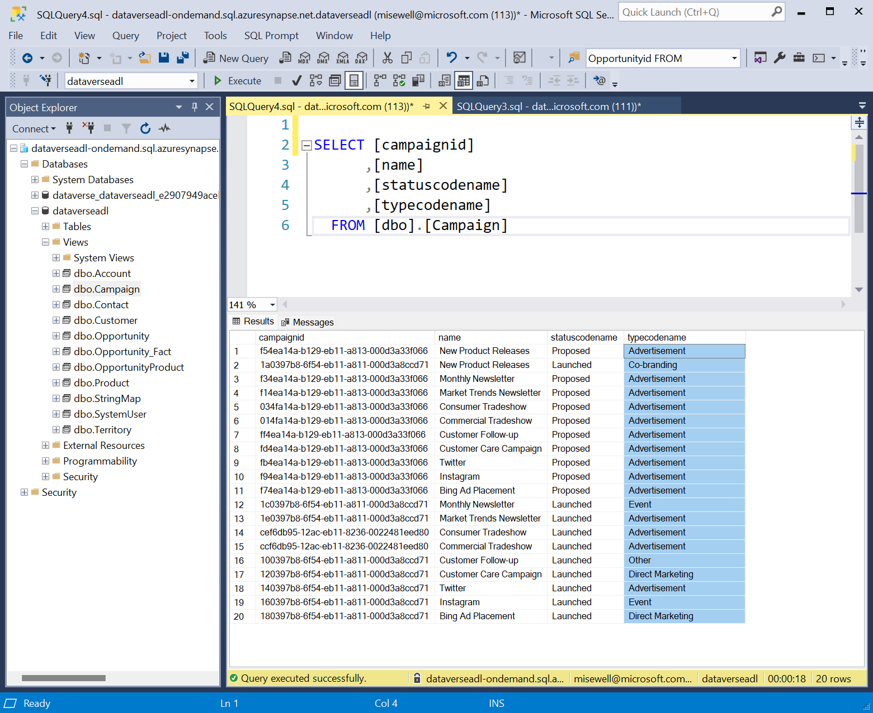
Create views for use as your report source.
Remove unneeded records and columns. Use the metadata views to resolve the choice labels and make it easier for your builders.

Slide 22
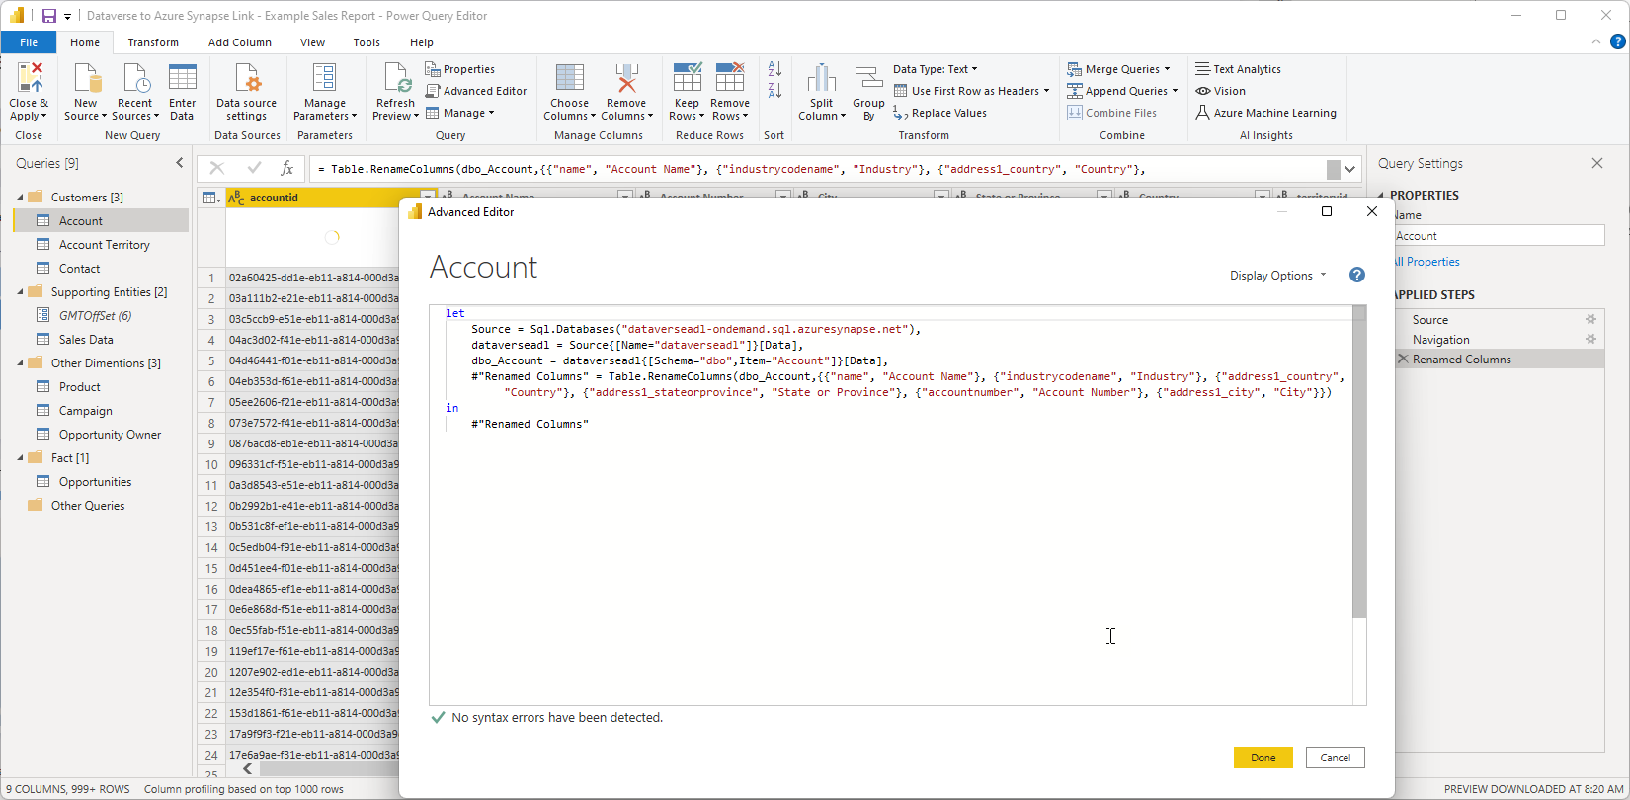
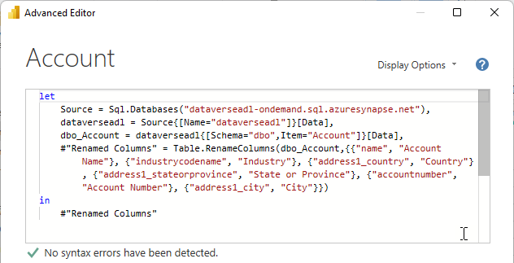
Connect Power BI to the new views

Slide 23
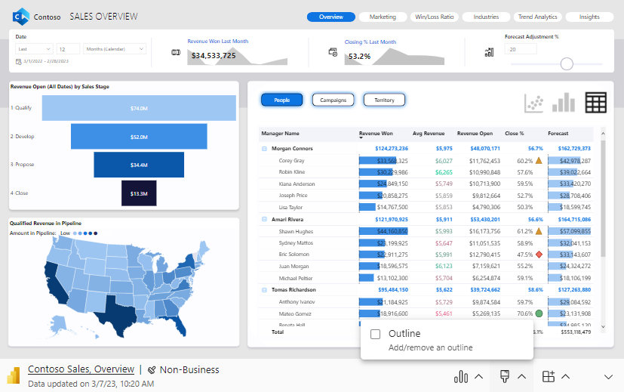
Completion of Basic Connectivity
Azure Synapse Link for Dataverse
Azure Synapse Analytics – Serverless SQL
Auto-Created Views
Custom Report Views
Azure Data Lake Storage

Slide 24
Thank You!

